Slide 1

Uber and Lyft prices prediction
STATISTICAL LEARNING FINAL PROJECT
Prof. ALBERTO ROVERATO
MANOJ KUMAR NAGABANDI
2039097

Slide 2
Obtaining Data
Source: Kaggle
Data collection: Website of Massachusetts State, USA
Data set of size 693,071 rows and 57 columns

Slide 3
Outline of the project:
Tidy
Tidy the data
Individuate
Individuate some outcome variables to study
Explore
Explore the data visually
Build
Build significative models
Interpret and justify
Interpret and justify the results

Slide 4
Features in Data Set
The rideshare dataset contain 56 features:
"id" , "timestamp" , "hour" , "day" , "month", "datetime" , "timezone”, "source“, "destination“, “cab_type”, “product_id”, “name”, “price”, “distance”, “surge_multiplier”, “latitude”, “longitude,"sunriseTime“, "uvIndexTime" ,"sunsetTime“,“short_summary”, “long_summary, "windGustTime“ ,“icon”
"visibility“, “dewpoint”, “pressure”, “windBearing”, “cloudCover”, “uvIndex”, “ozone”, “moonPhase”, "precipIntensityMax“, “precipIntesity”, “precipProbability, ”, “humidity”, "windSpeed" , "windGust“, , “visibility.1”
"temperatureMin" , "temperatureMinTime“, "temperatureMax" , "temperatureMaxTime“, "apparentTemperatureMin" , "apparentTemperatureMinTime“, "apparentTemperatureMax" , "apparentTemperatureMaxTime" , “temperature” , “temperatureHigh”, "temperatureHighTime“, "temperatureLow“, “apparentTempertaure”, "temperatureLowTime“.
Climate Related features
Temperature related features

Slide 5
Clean & Filter Data(Pre-processing)
Initially, checks for NAN, infinite values, and missing values are done and 55,095 missing values are present in the data which are omitted.
Both “visibility” and “visibility.1“ features have exactly the same data in their columns one of them is dropped.
Checks for skewness are done on all numeric features and 15 features are found to be negatively skewed and 26 features are found to be positively skewed.
Since skewness is greater than 3 for "surge_multiplier“ and "precipIntensity" features we apply cube root transformation is applied to normalize and reduce the skewness of the features.

Slide 6


Clean & Filter Data(Pre-processing)
Outliers are found by using the interquartile range.
Features whose outliers(>10%) are:
latitude ← 0.127 %
Visibility ← 0.197 %
temperatureHigh ← 0.236 %
apparentTemperatureHigh ← 0.103 %
apparentTemperatureLow ← 0.126 %
temperatureMax ← 0.197 %
apparentTemperatureMin ← 0.109 %
After deleting rows with outlier values, the final dimension used is 293877 rows and 56 columns.

Slide 7
Clean & Filter Data(Pre-processing)
There are 11 features with character datatype are:
Id, datetime, timezone, source, destination, cab_type, product_id, name, short_summary, long_summary, icon
Since every row of the “id” feature values are unique and every row of the “timezone” feature has the same value.
From the above 2 features model does not learn anything so they can be discarded.
Finally, in the feature “product_id” we have unidentified information so this feature can be dropped as well.
Therefore, there are 8 categorical features remaining to which one hot encoding is applied to convert them to binary vectors
Therefore, the final size of our data frame is 293,877 rows and 102 columns

Slide 8
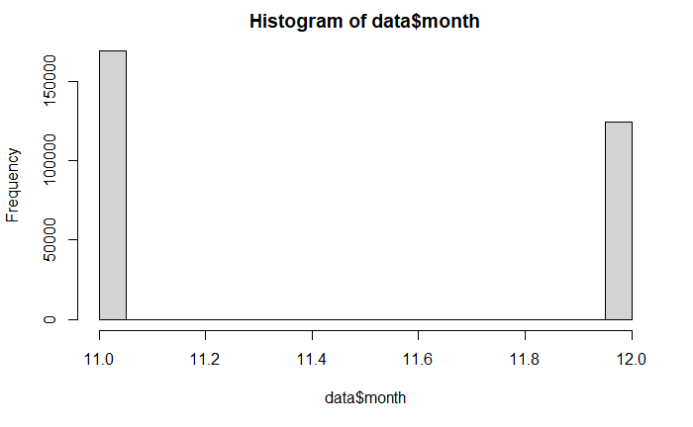
Exploratory Data Analysis (EDA)
In which months did most of the rides occur?
It appears that we only have November and December data in our monthly data
November ←169512 values December ←124365 values
Notes:
In this section, we will look deep into the characteristics of each variable using visual methods like histograms and boxplots.

Slide 9
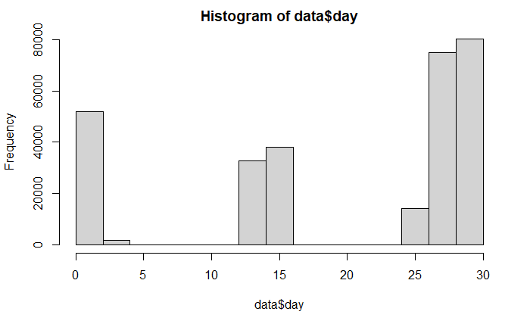
Exploratory Data Analysis (EDA)
On what dates most rides have not taken place?
We have many gaps in data between 4th - 12th days and from 17th - 25th days data are not present in each month

Slide 10
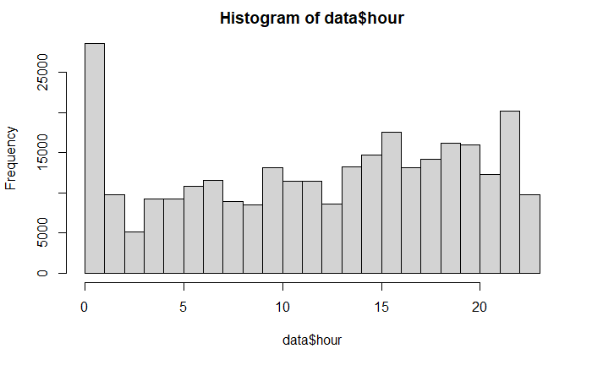
Exploratory Data Analysis (EDA)
How many hours of data are logged?
We have logged data of 24hrs

Slide 11
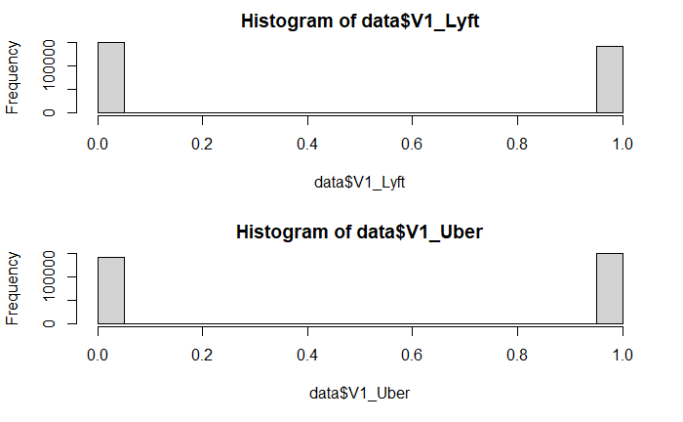
Exploratory Data Analysis (EDA)
What company cabs are used more?
Uber and Lyft categories have almost same size
Uber ← 151,560 values
Lyft ← 142,317 values

Slide 12
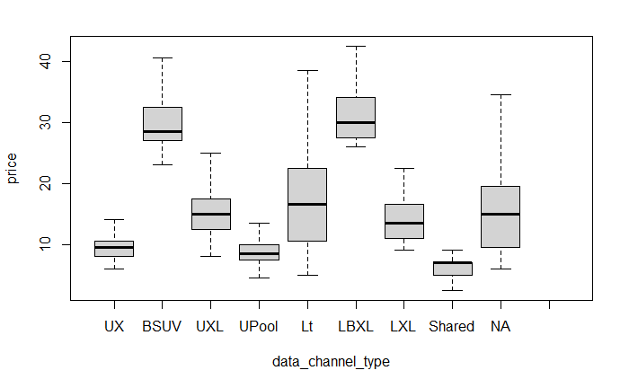
Exploratory Data Analysis (EDA)
Which cab has best price per mile?
Firstly, Lyft XL has a slightly lower fare per mile than UberXL.
Uber Black SUV shows a lower rate than Lyft Black XL.
Lyft’s ordinary ride when compared to UberX has higher fares per mile.

Slide 13
Model Building
293,877 rows are taken and randomly split into training(60%), test(20%), and validation(20%) sets which are used to train, validate and test the model.
Before building a linear model 4 assumptions are needed to be checked.
The checking of assumptions are done by training 3 models below:
1) linear model
2) linear model with log applied
3) linear model with sqrt appled

Slide 14
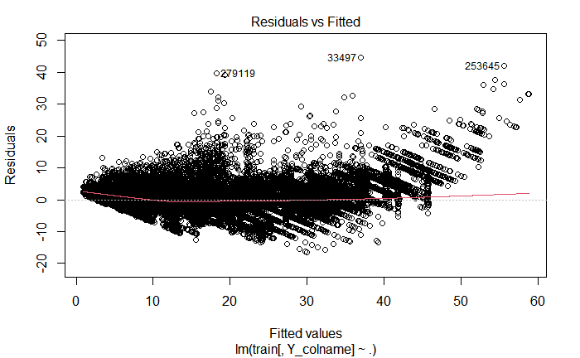
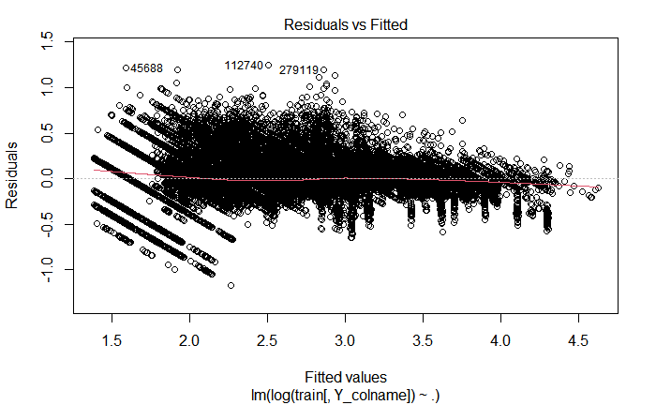
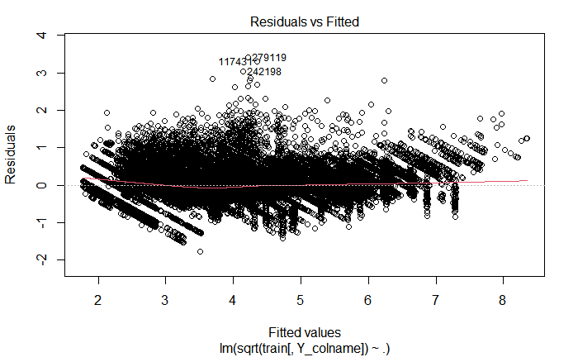
There are 4 assumptions considered for linear regression are :
1) There is a linear relationship between the predictors (x) and the outcome (y).
2) Residual Errors have a mean value of zero.
Notes:
Here, we need to pay attention to the Y-axis scale which is where the difference is clear the model with log(Y) transformation has centric residuals around zero.
From the residual plots, we can see that the GLM model has almost zero mean of residuals.

Slide 15
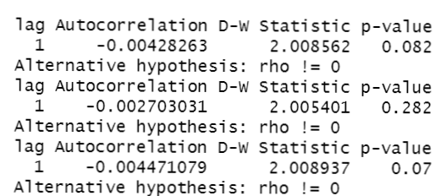
3) Predictors (x) are independent and observed with negligible error
We use Durbin Watson test in which null hypothesis of the test states that there is no auto-correlation of residuals.
Implicitly, our target has enough evidence and fail to reject H0 hypotheses.
Therefore all 3 models which we assumed have no auto correlation among their predicted variables.

Slide 16
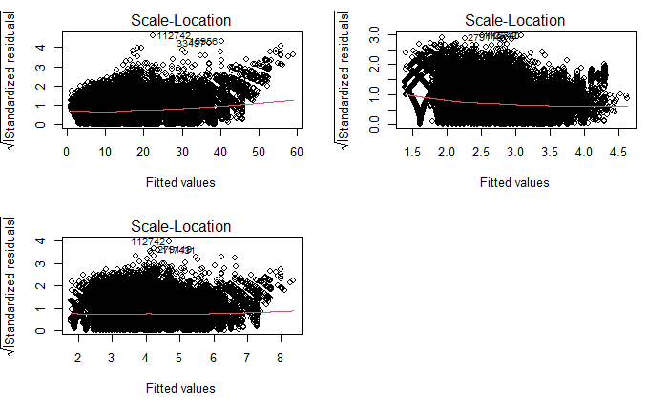
4) Residual errors have constant variance
The red line is roughly horizontal across the plot.
But, to check homoscedasticity we use Breusch-Pagan Test since it is not clear from the red line that we have constant variance.
Notes:
The scale location plot is assumed to be centered around zero.
The spread of the residuals is roughly equal at all fitted values therefore variance is constant across the entire range .

Slide 17
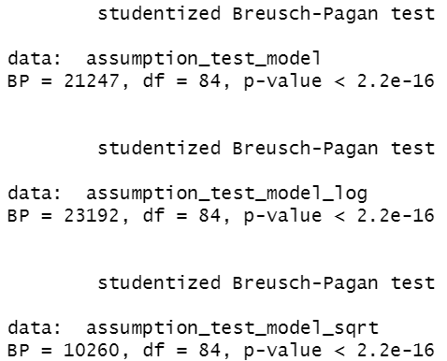
Breusch-Pagan Test
From the output we can see that the p-value of the test is less than 0.05, we reject the null hypothesis.
We have sufficient evidence to say that heteroscedasticity is present in the regression model which means there may be some non constant variance which is not desirable.
Notes:
Basically, Null Hypothesis (H0): The residuals are homoscedastic (i.e. evenly spread)
Alternative Hypothesis (HA): The residuals are heteroscedastic (i.e. not evenly spread)

Slide 18
Several assumptions are satisfied by 3 linear models.
Now, we experiment with the following models by training them: - Full linear model - Poisson GLM (log transform of target variable) - Backward and forward coefficients selection is done and best models, based on Bayesian Information Criterion and Mallow's Cp coefficient are trained.
After training the models, we compare and select the best in terms of: - Adjuster R squared - Akaike Information Criterion - Bayesian Information Criterion - Number of parameters - Validation R squared

Slide 19
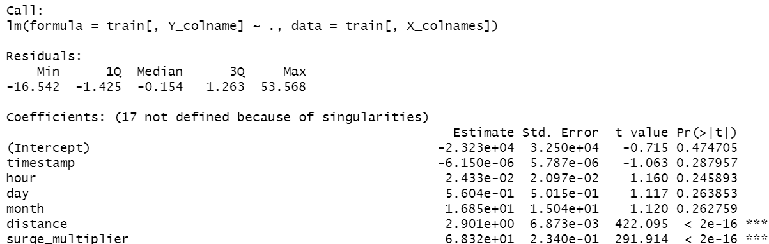
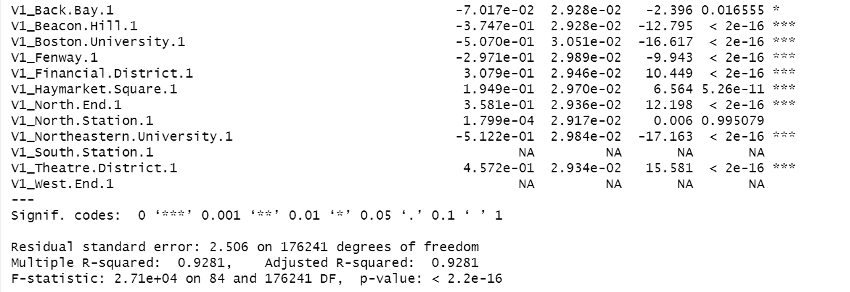
1)Full linear model
The adjusted R squared for the full linear model is 0.9247 with p-value less than 0.05
With other techniques, we will try to improve these metrics while decreasing the number of parameters considered.
Notes:
Having high R^2 the best fit line passes through many of the data points in the regression model
Since P value is less than 0.05 % which means that all independent variables w.r.t dependent variables are statistically significant.

Slide 20
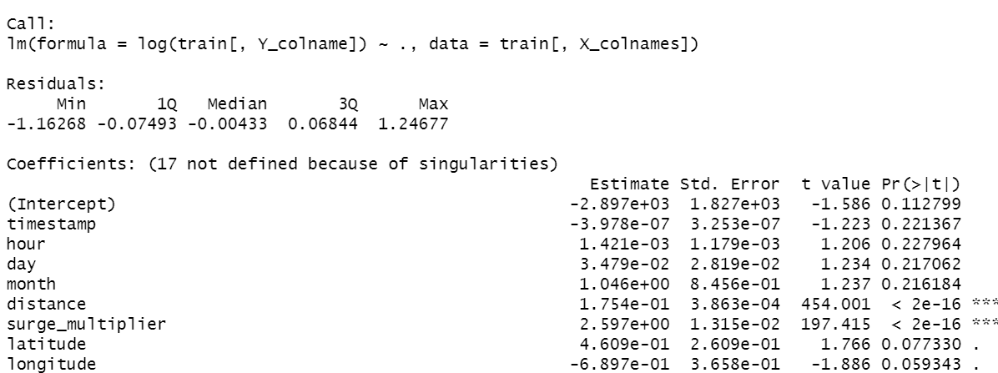
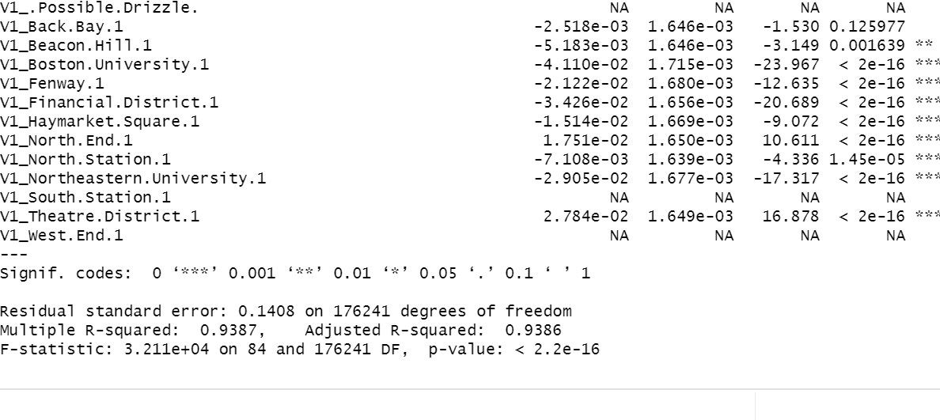
2)Poisson GLM
Log transformation is used to increase R squared up to 0.9386 from 0.9247.
To improve these metrics while decreasing the number of parameters considered forward and backward selection are used.

Slide 21
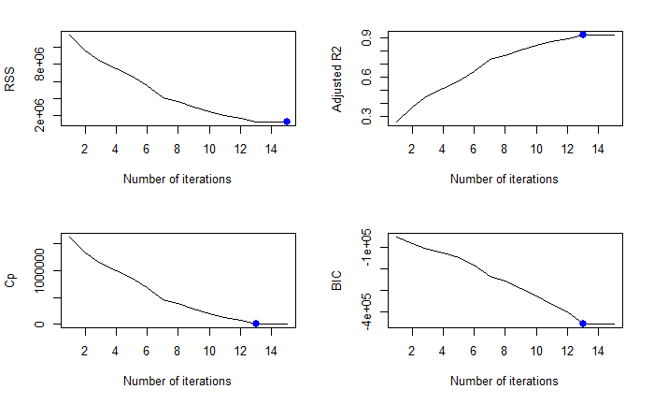
3) Linear model (forward / backward model selection)
Forward subsets
Many correlated indices were removed by trial & error method and nvmax is chosen 15 for both forward and backward subset selection.
Notes:
Basically, nvmax represents the maximum number of predictors to incorporate in the model

Slide 22
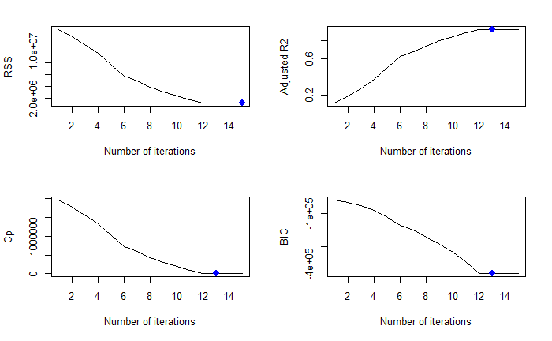
3) Linear model (forward / backward model selection)
Backward subsets
Best number of parameters in Backward selection and Forward selection are same with
BIC →13
Cp →13

Slide 23
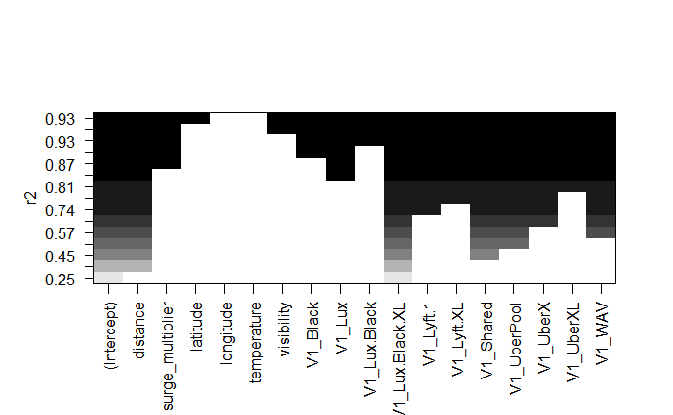
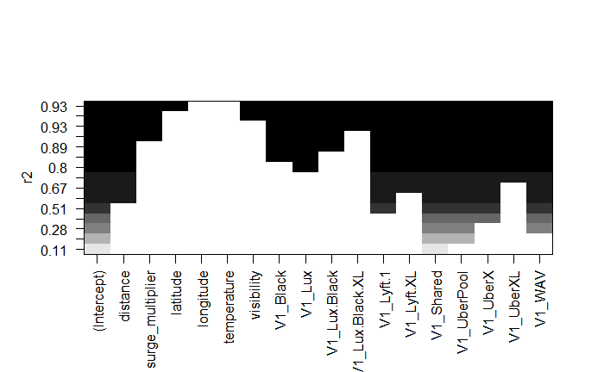
forward
To represent the most significant variables, we used variable elimination plots based on r^2 value.
After elimination of variables, best BIC and Cp model are retrained.
backward

Slide 24

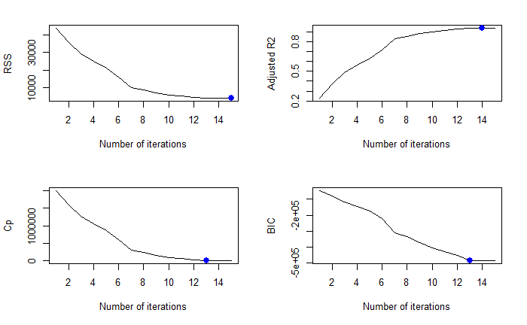
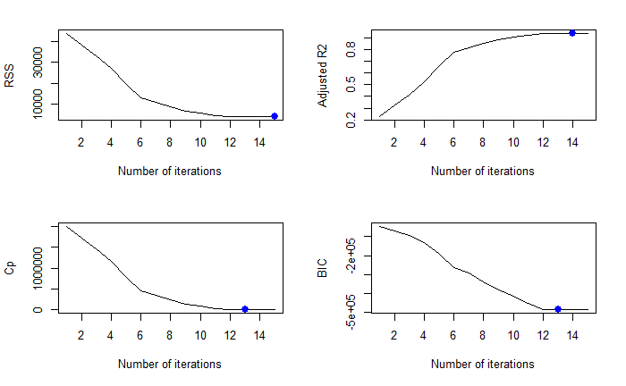


4) Forward / backward selection for log(Y) transform
Forward subsets
Backward subsets
Number of best coefficients for both selections are BIC→13 & Cp→13

Slide 25
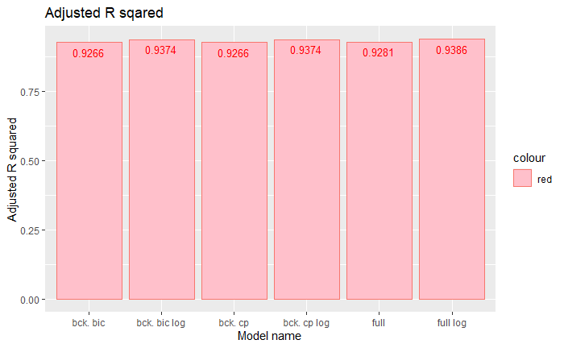
Comparison of models
Comparison of adjusted R^2
From the plot we can say that independent of parameter selection technique generalized linear model was capable of achieving better R^2 results.

Slide 26
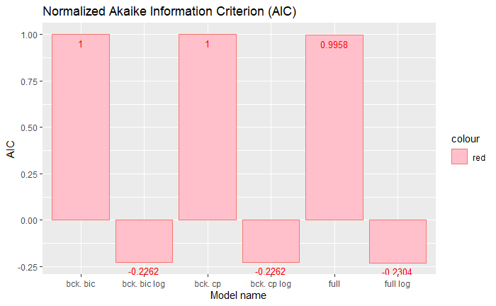
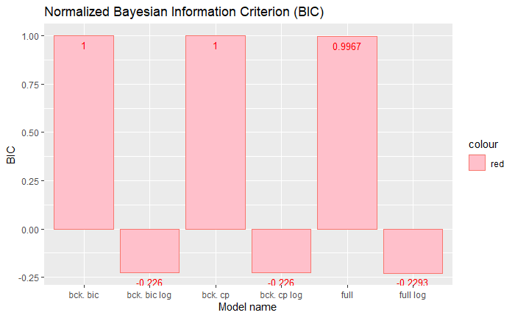
2)Comparison of AIC and BIC
A remarkable difference is also observed in terms of Akaike and Bayesian information criteria
The lower the AIC and BIC the better, and a negative AIC or BIC indicates a lower degree of information loss than a positive AIC or BIC

Slide 27
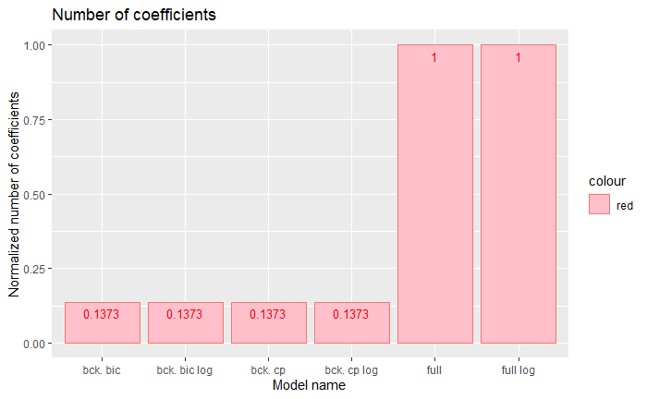
4)Comparison based on number of parameters
A powerful result can be made here - having up to 87 percent less parameters, the lightweight models like GLM with backward selection and GLM log model with backward selection were able to achieve better R squared metrics with less parameters.

Slide 28
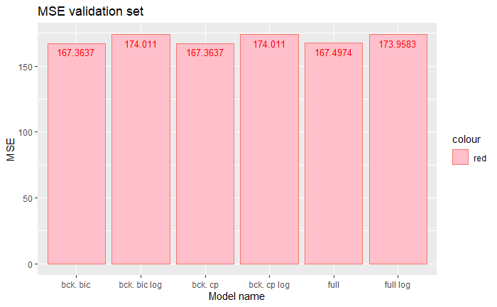
5)Comparison Based on Validation Set.
On the validation set, all models achieved comparable results.
Conclusion:
The best model is a Poisson GLM, with backward coefficients selection.
It has 87% less parameters than full model, allowing for around 0.9386 adjusted R squared.

Slide 29

Thank you

